Slide 1


Slide 2
Meeting ABB Cobot Lab
25.11.2021
Dr. Petrus Aejmelaeus-Lindström
Lecturer and MAS DFAB Cordinator

Slide 3





MAS in Architecture and Digital Fabrication MAS ETH DFAB

Slide 4
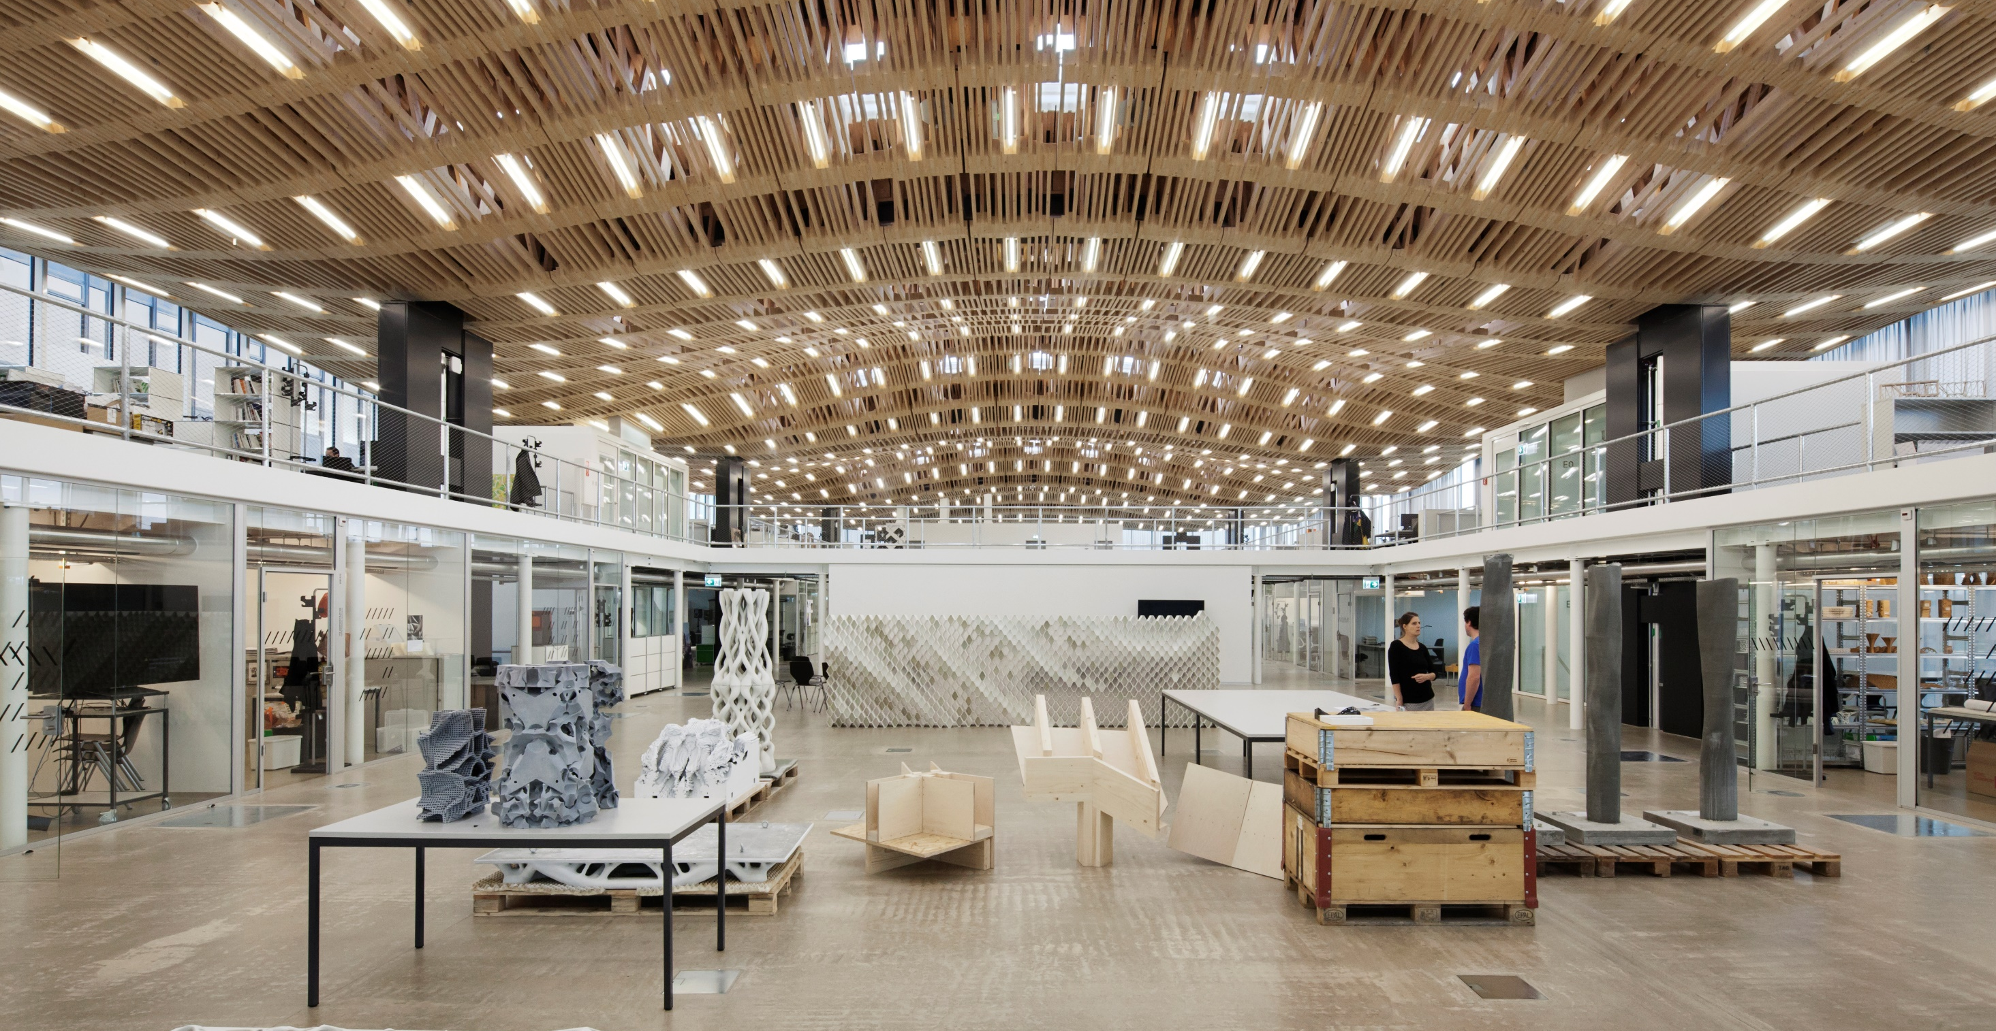
The Arch_Tec_Lab (HIB), home of the Institute of Technology in Architecture (ITA) and the NCCR DFAB

Slide 5
MAS ETH DFAB
The Master of Advanced Studies in Architecture and Digital Fabrication is an intensive twelve-month postgraduate programme run jointly by Digital Building Technologies and Gramazio Kohler Research.
The curriculum combines two of the most rapidly developing fields in architecture: 3D printing and robotic fabrication.
It equips students with the technical, intellectual and artistic skills to master the digital chain from computational design to full scale building tasks.

Slide 6
The MAS Year 2019-2020
Trimester 1 Digital Foundations
Trimester 2 Design and Fabrication Project 1 - DBT
Design and Fabrication Project 2 - GKR
Trimester 3 Research - Master Thesis

Slide 7
MAS ETH DFAB: The Design and Fabrication Project
The second trimester of the MAS programme is split into two consecutive full-scale design and fabrication projects. The students work collaboratively on all aspects from computational design to the digital and robotic fabrication of their 1-1 scale structure. They acquire in-depth knowledge and experience in the project management of digitally driven construction projects and develop integrated digital fabrication processes at the forefront of architecture.
In the past years this has resulted in the double-storey Robotic Timber Pavilion, Liquid Metal Pavilion, the Brick Labyrinth, Gradual Assemblies for the Istituto Svizzero in Rome, Concrete Choreography for the Origin Festival in Rio and Up-Sticks for the V&A museum in Dundee.
These projects have underlined the position of the MAS ETH DFAB as a world-leading post-graduate Master programme in the field of digital fabrication in architecture. Several international publications have underlined the highly innovative character of all projects.

Slide 8
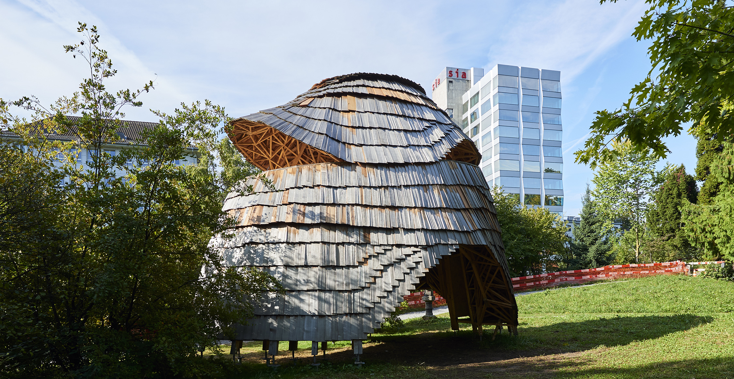
Brick Labyrinth, ETH Zurich

Slide 9
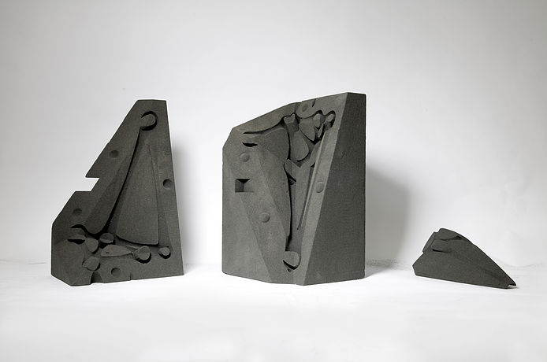
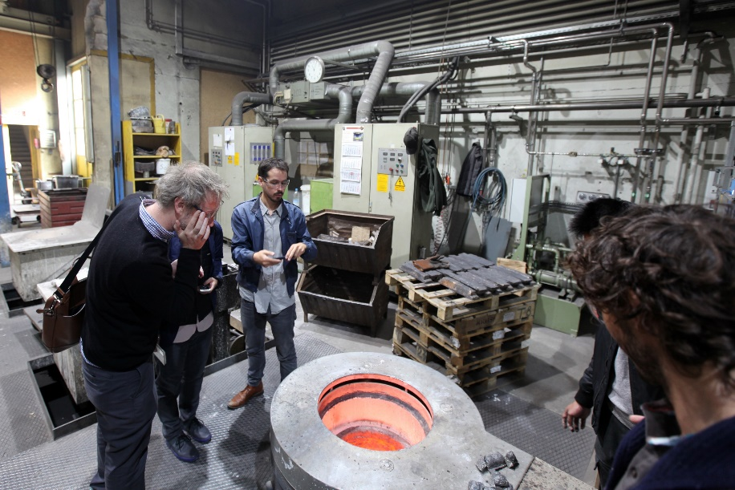
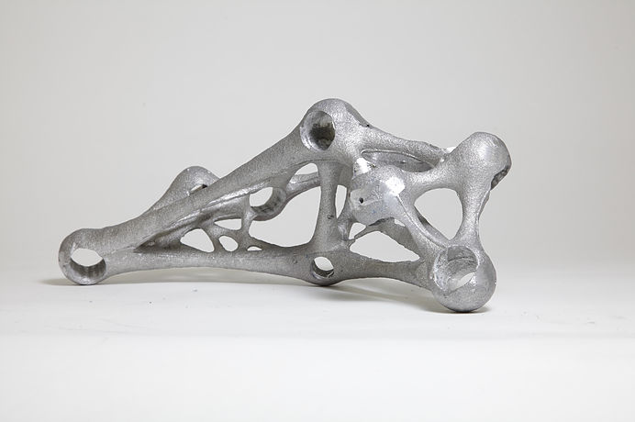

Slide 10
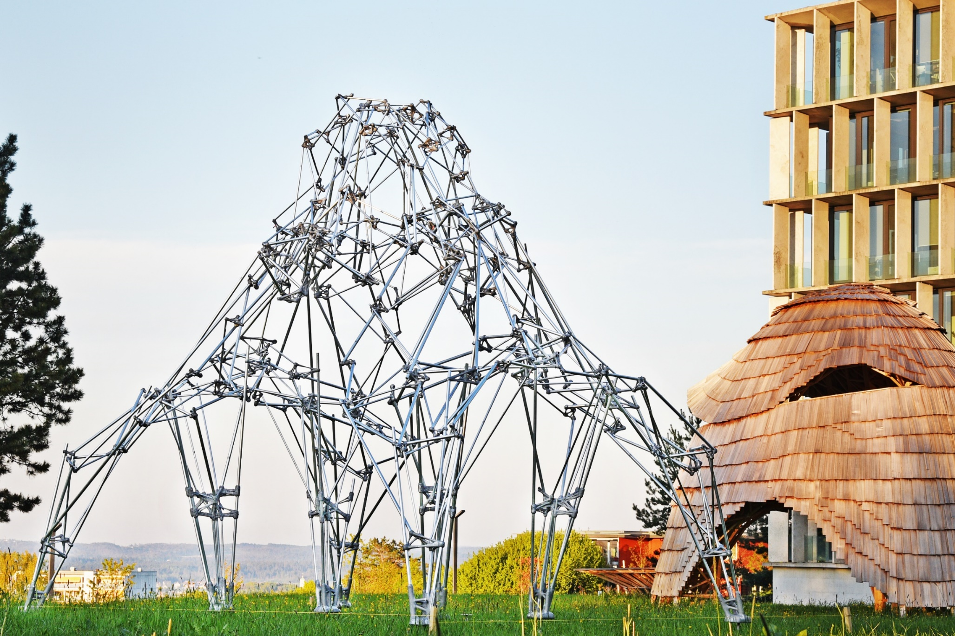
reviews as exhibitions

Slide 11
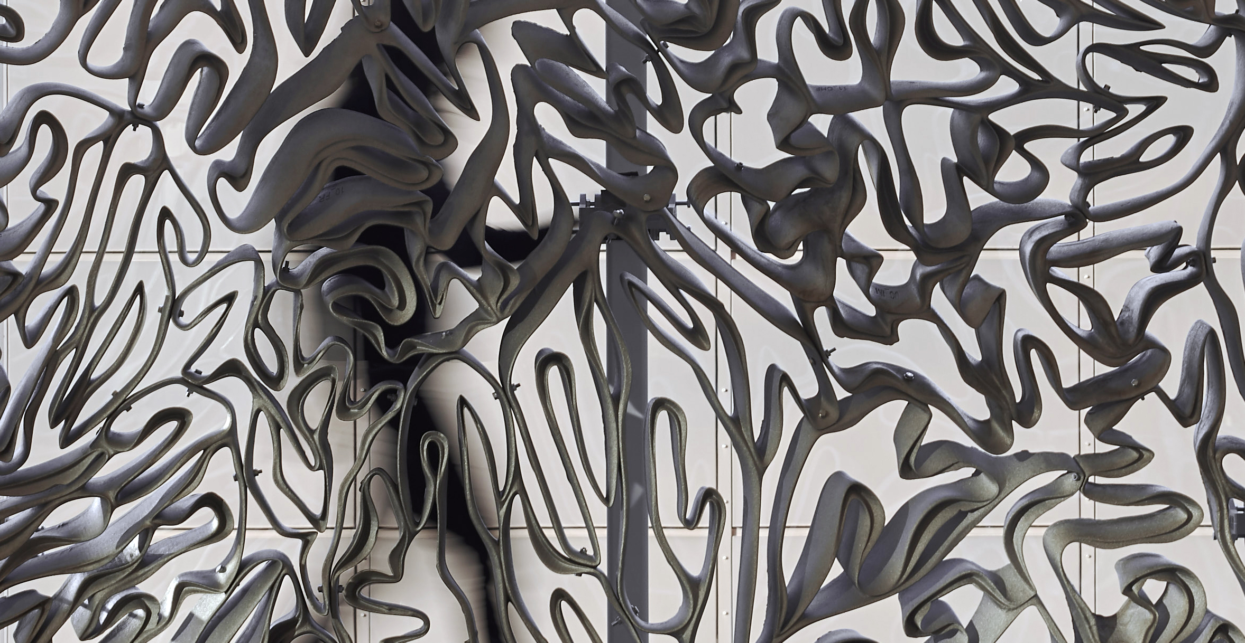
Brick Labyrinth, ETH Zurich

Slide 12
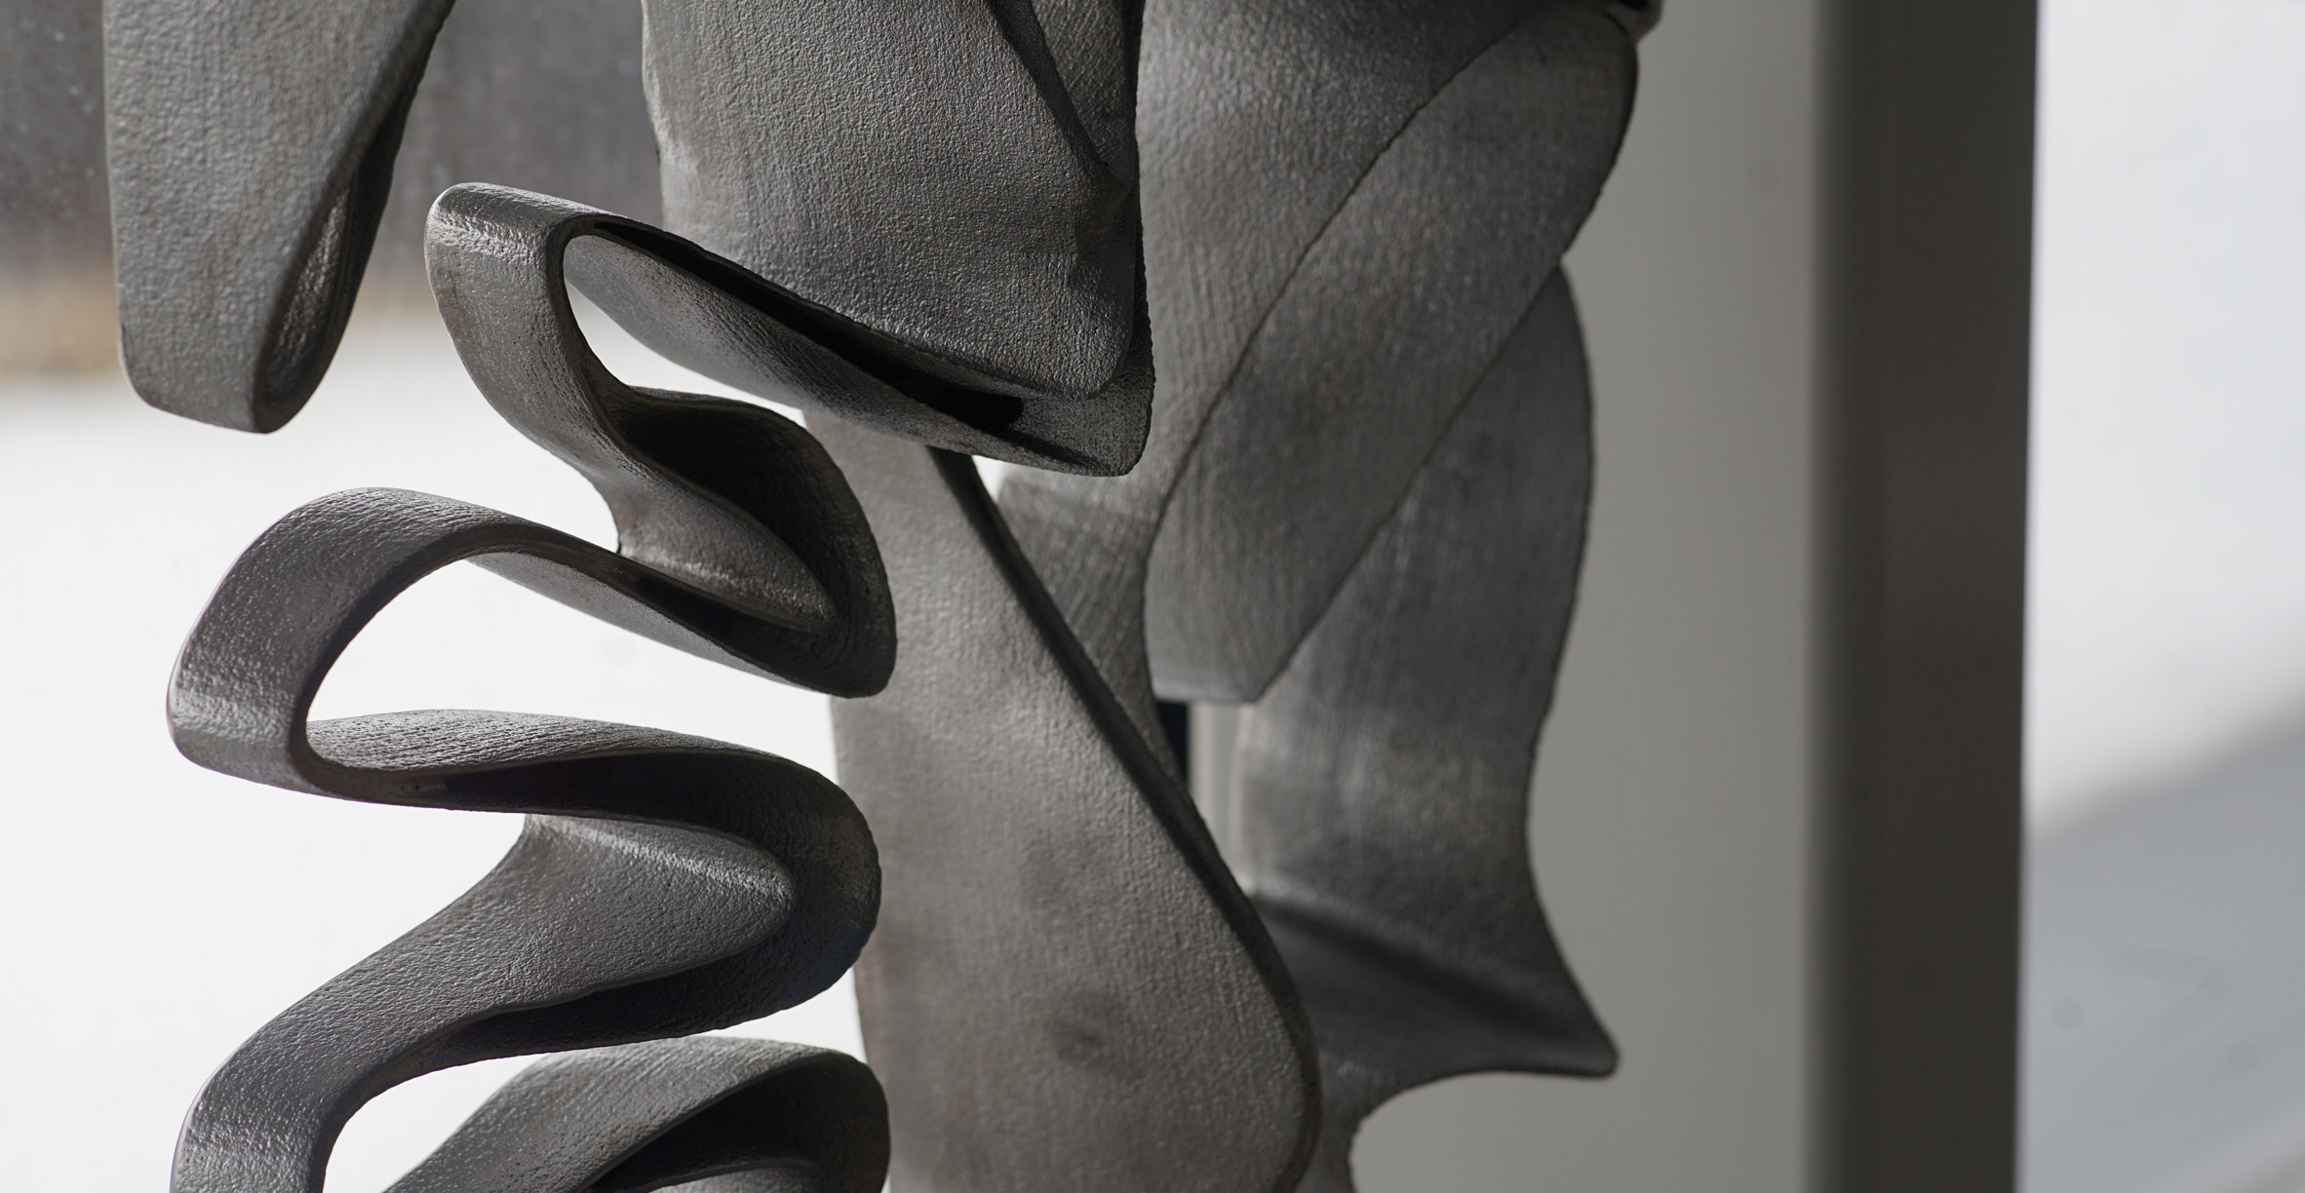
Brick Labyrinth, ETH Zurich

Slide 13
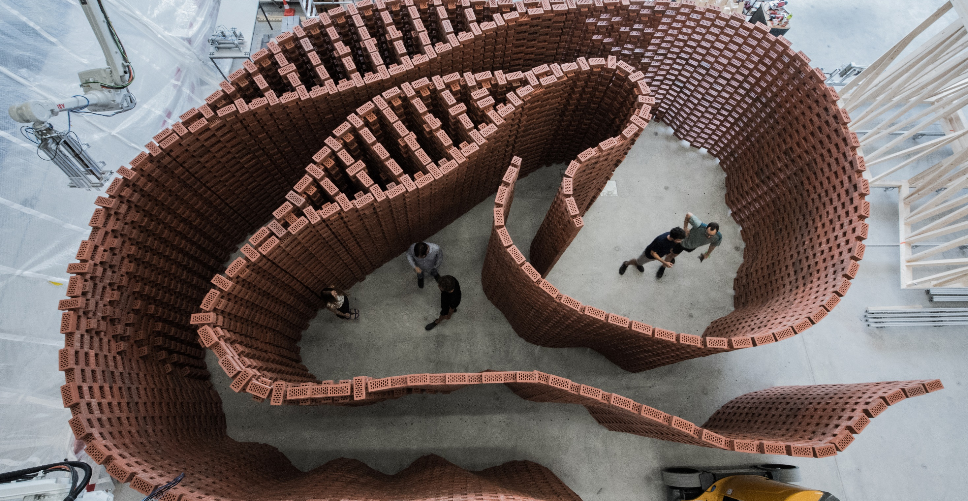
Brick Labyrinth, ETH Zurich

Slide 14
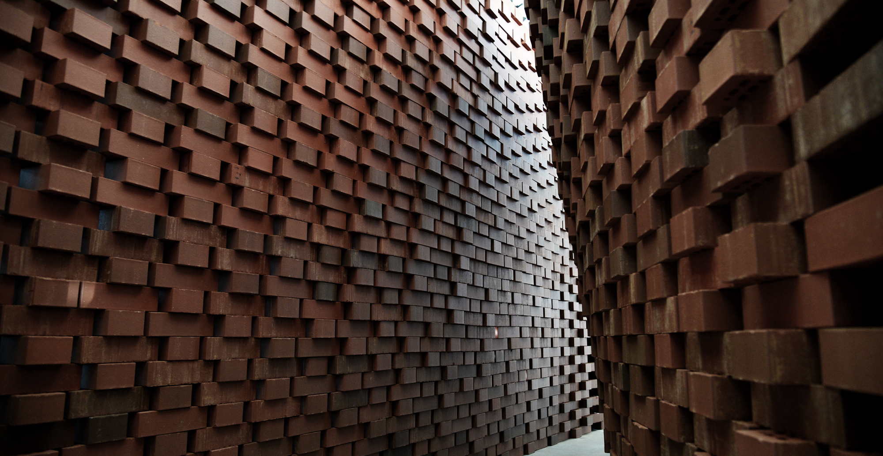
Brick Labyrinth, ETH Zurich

Slide 15
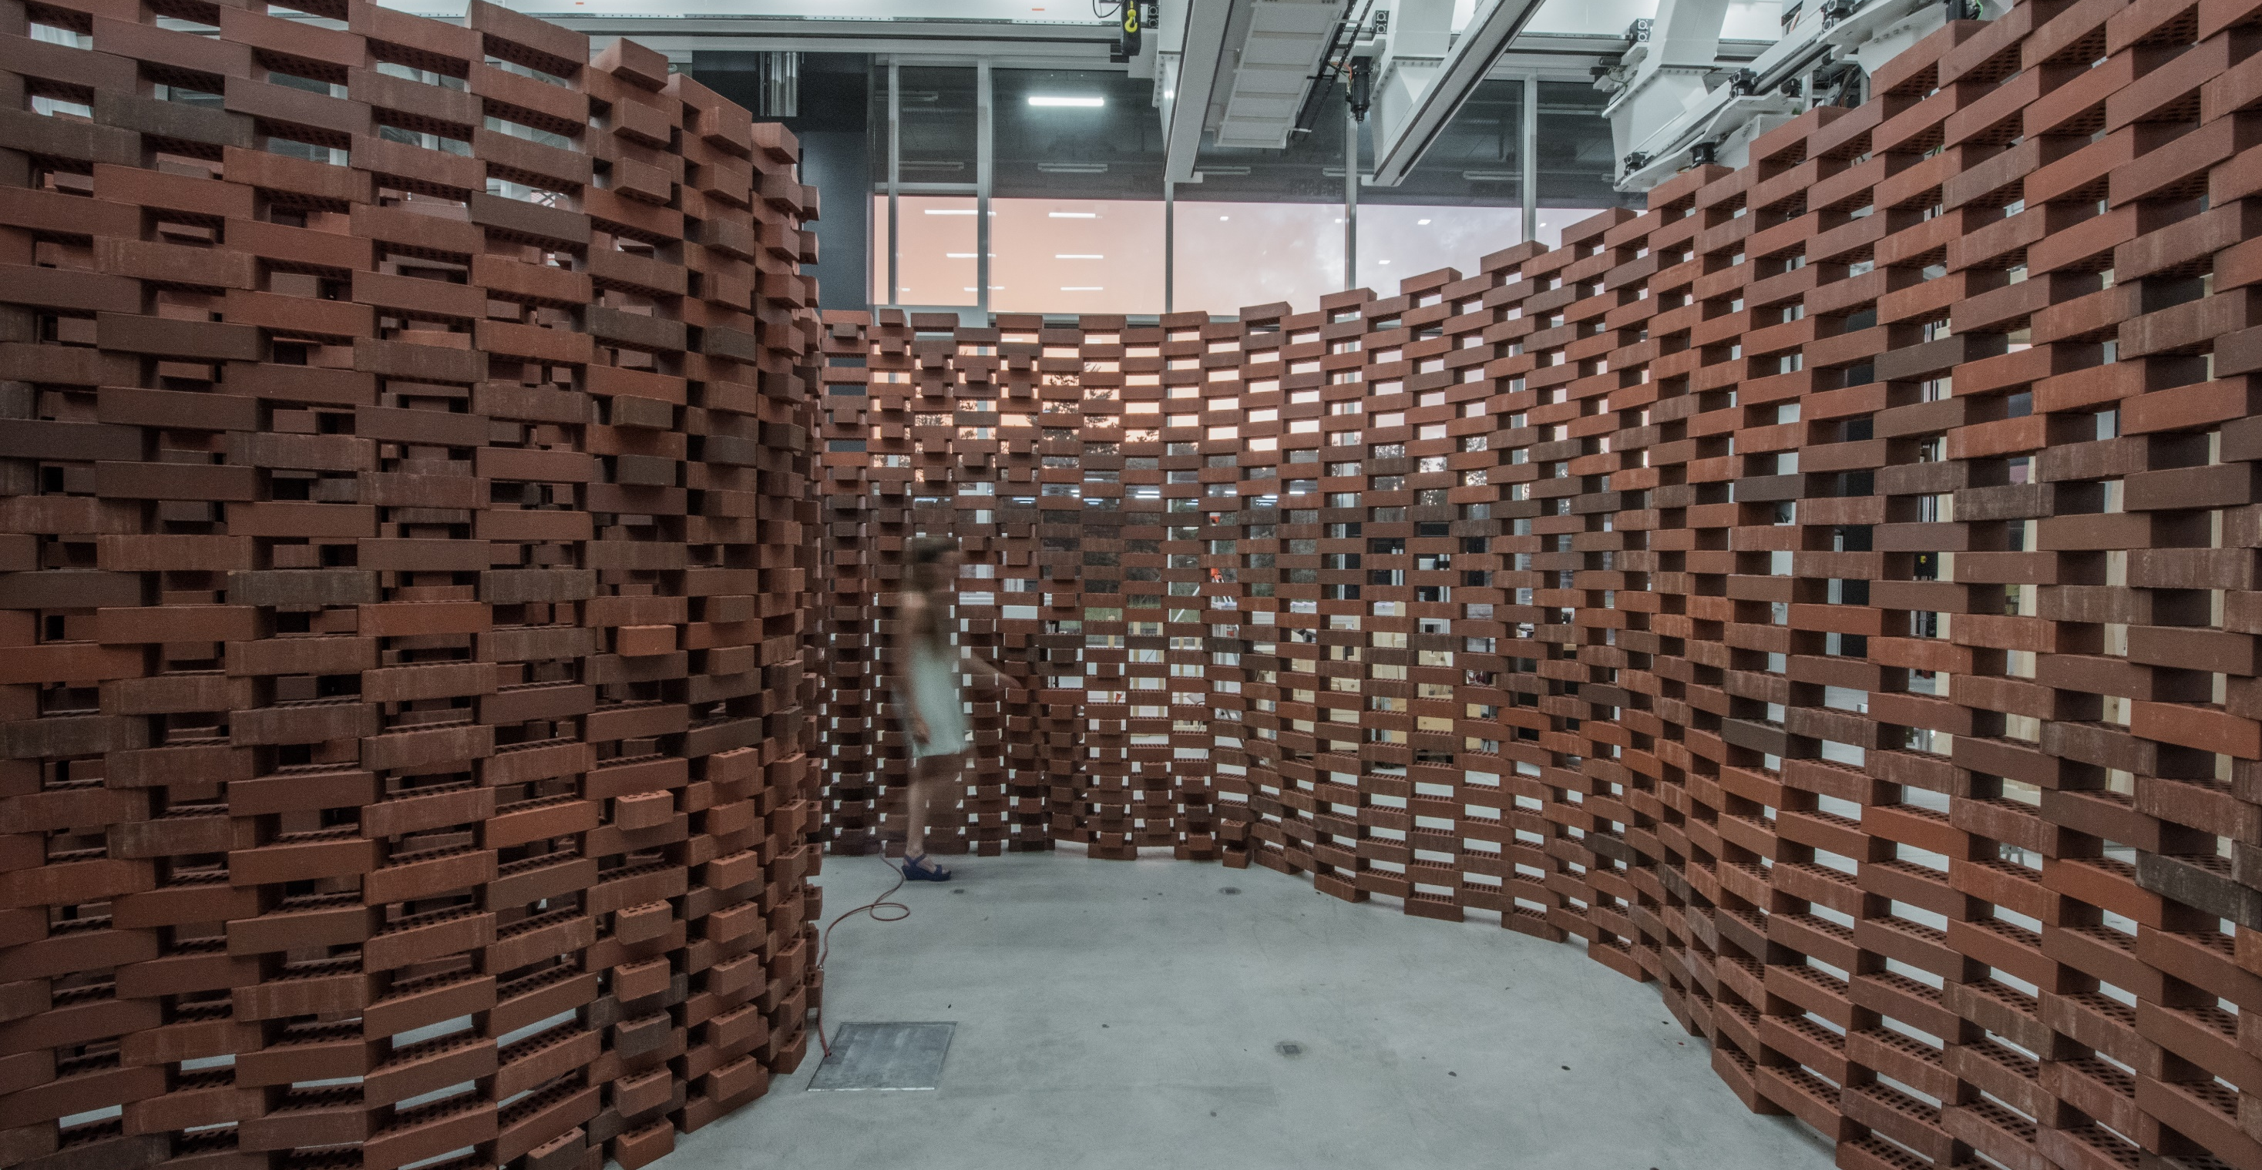
Brick Labyrinth, ETH Zurich

Slide 16
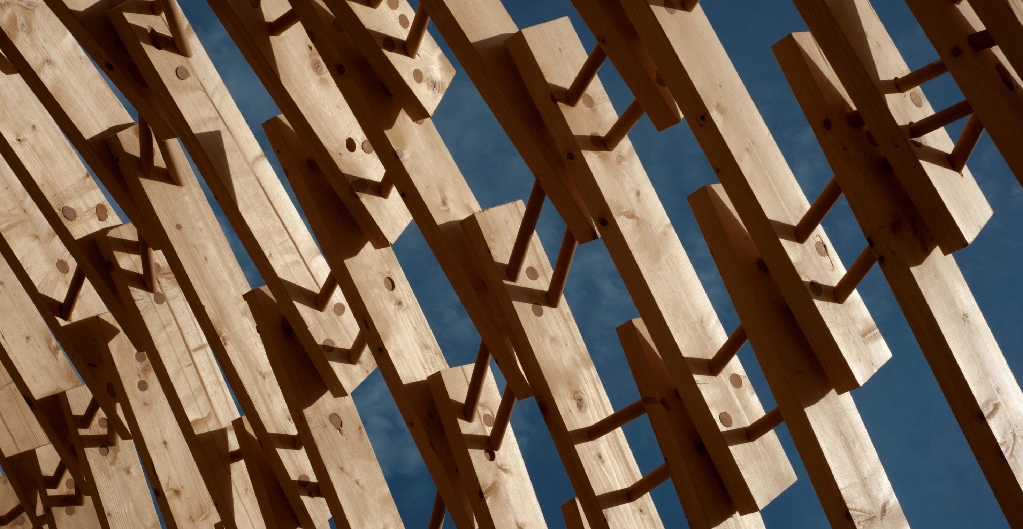
Brick Labyrinth, ETH Zurich

Slide 17
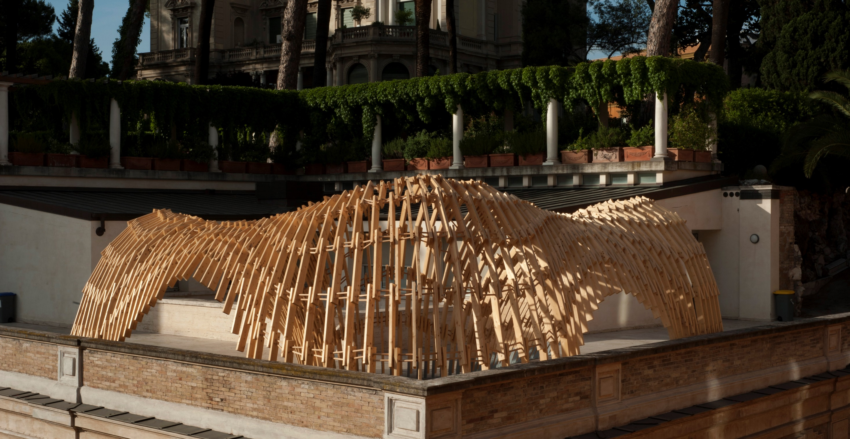
Brick Labyrinth, ETH Zurich

Slide 18
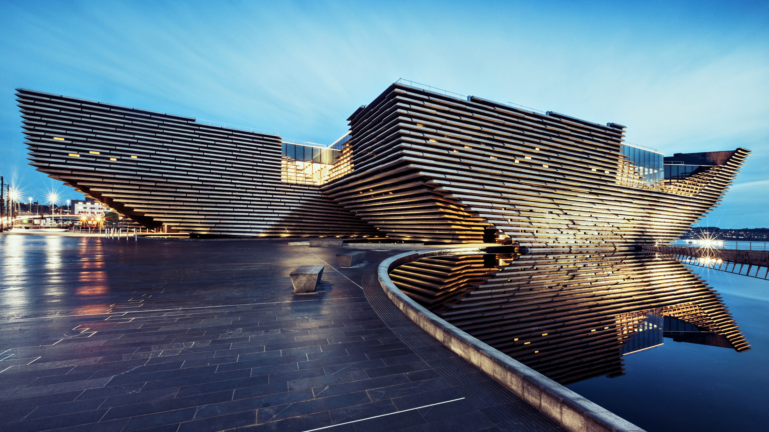
V&A Dundee, image from arup.com, © Ross Fraser McLean

Slide 19
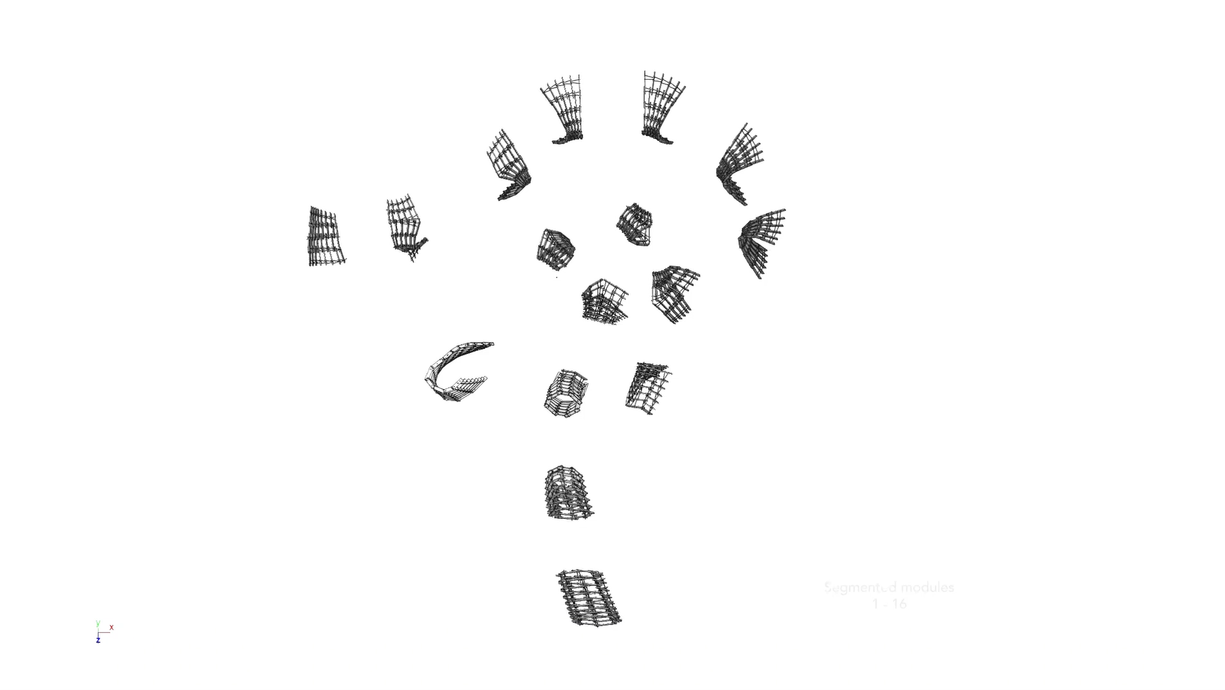

Slide 20
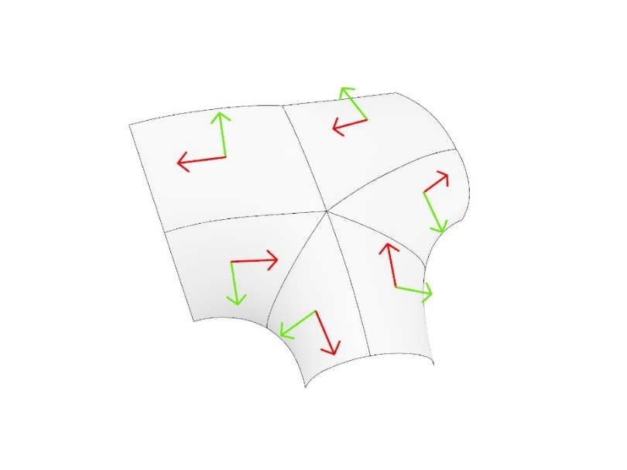
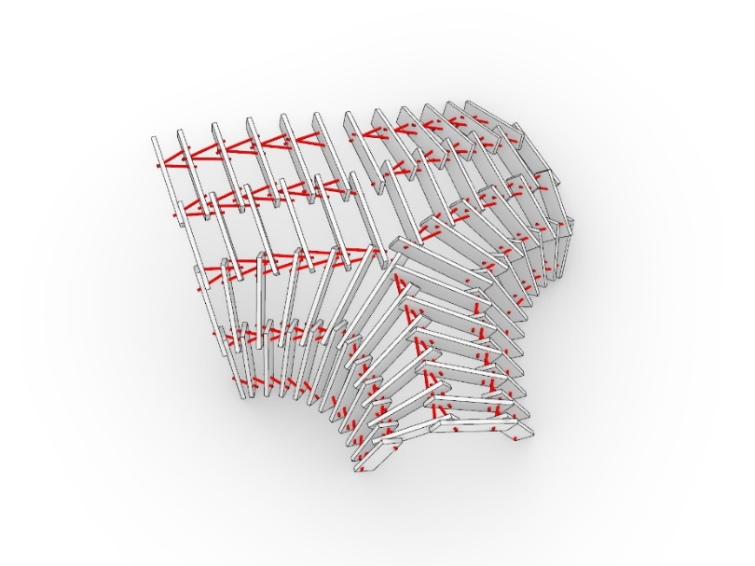
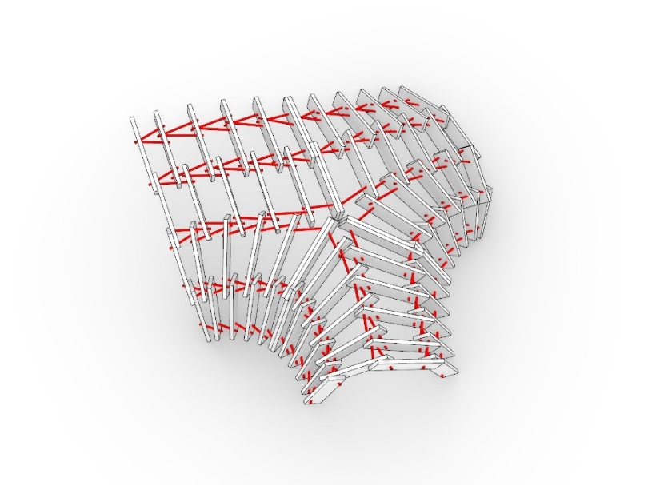

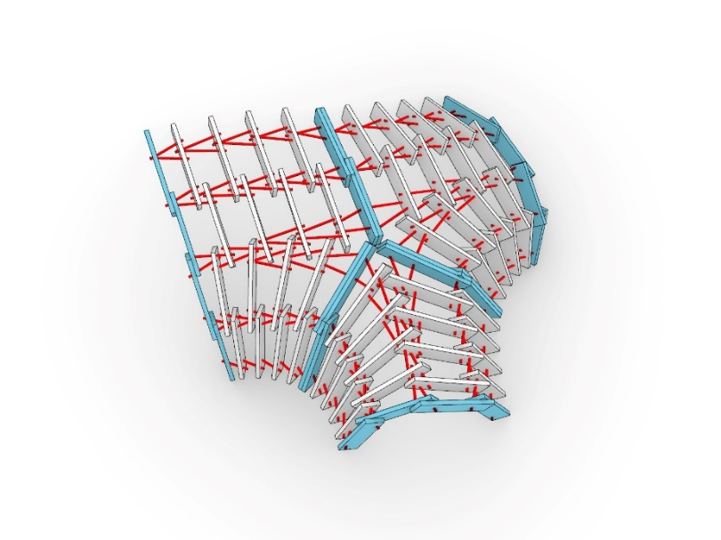
Surface domains (UV), 6 base surfaces
Alignment problems between surfaces
Flipping directionalities
Additional dowel connections
Seams between three modules
Distribution along a seam between three modules, flipping of directionality and generation of additional dowel connections

Slide 21
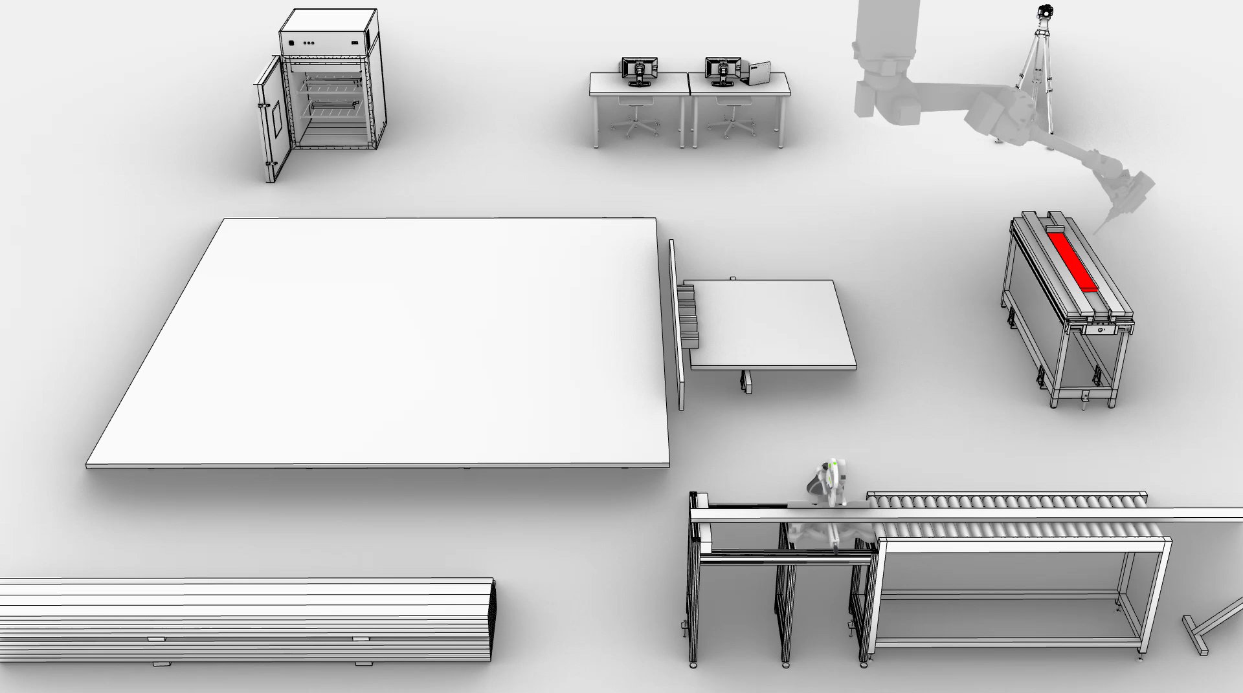
Fabrication sequence of one module

Slide 22
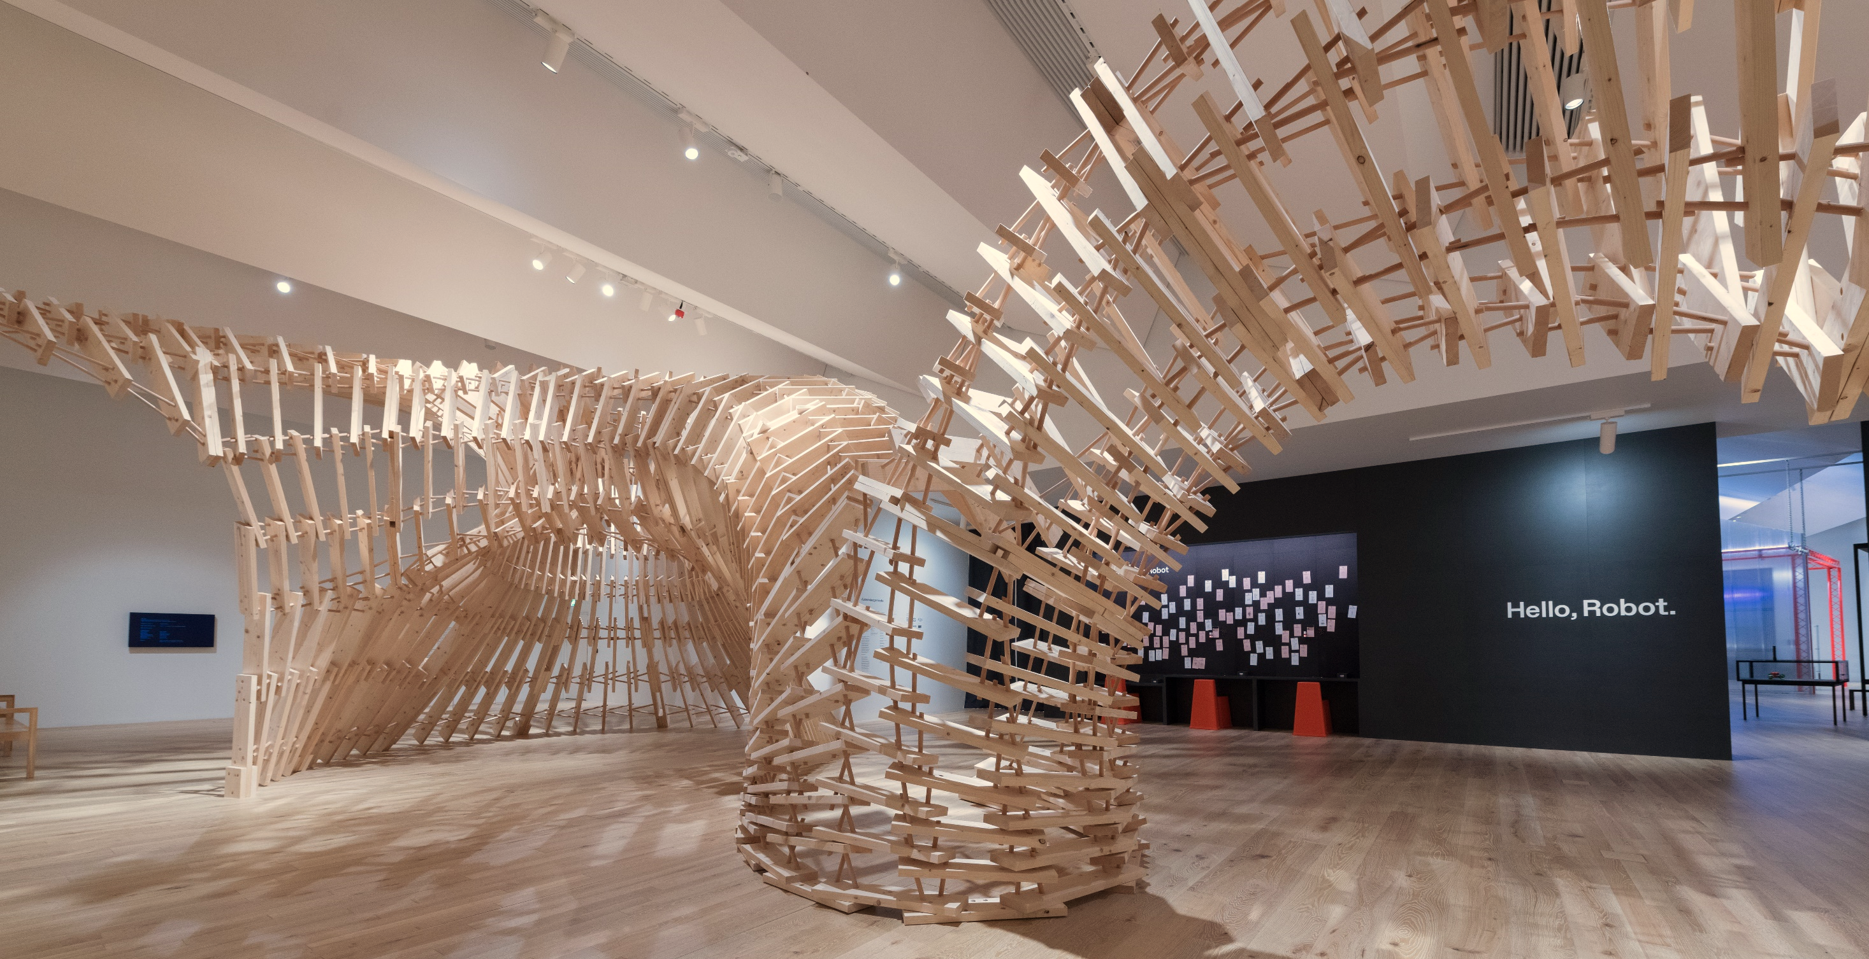
Up Sticks, V&A Dundee

Slide 23
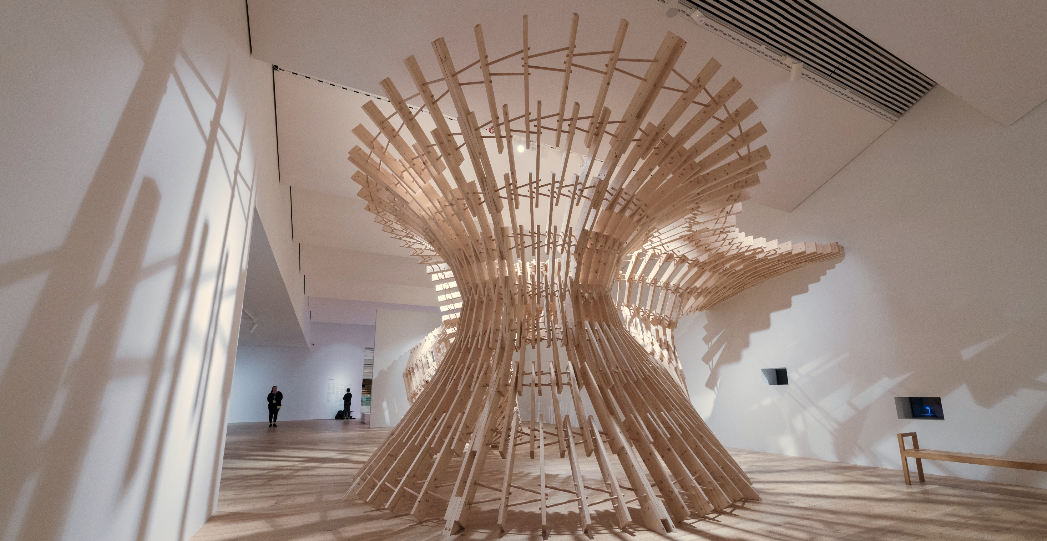
Up Sticks, V&A Dundee

Slide 24
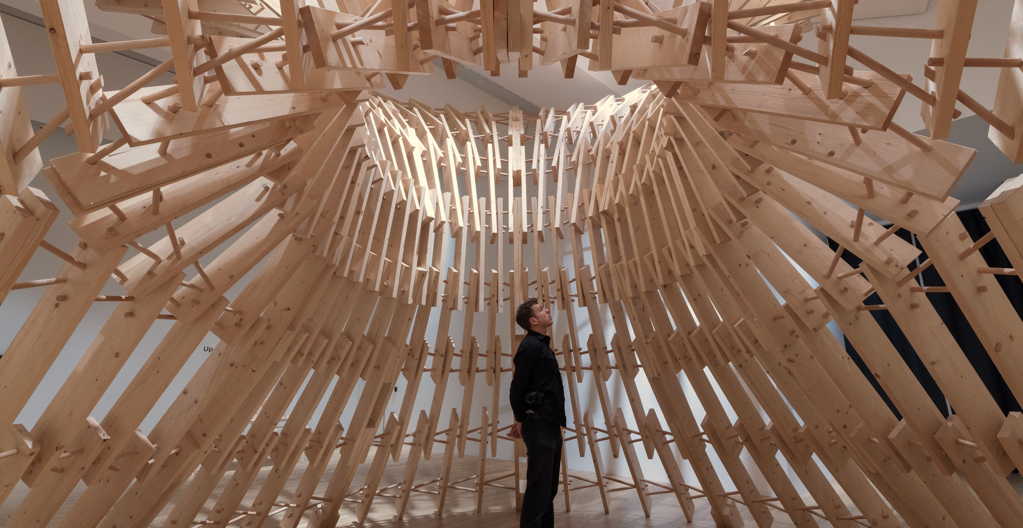
Up Sticks, V&A Dundee
Notes:
Wenn Studenten mit Hilfe digitaler Werkzeuge das hinbekommen, zeigt es doch was in der Industrie möglich sein sollte.

Slide 25
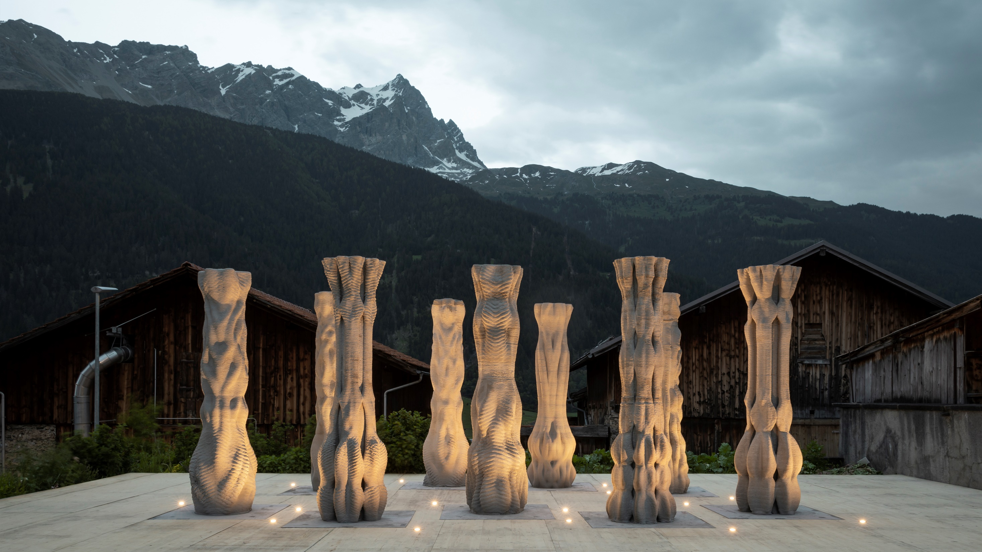
Concrete Choreography, Origen Festival 2019, Riom, CH

Slide 26
Eggshell Pavillion MAS DFAB T2 2022

Slide 27
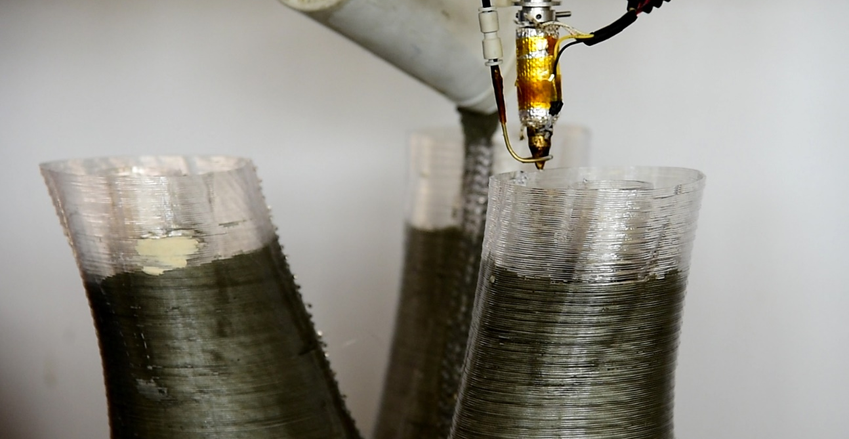

Slide 28
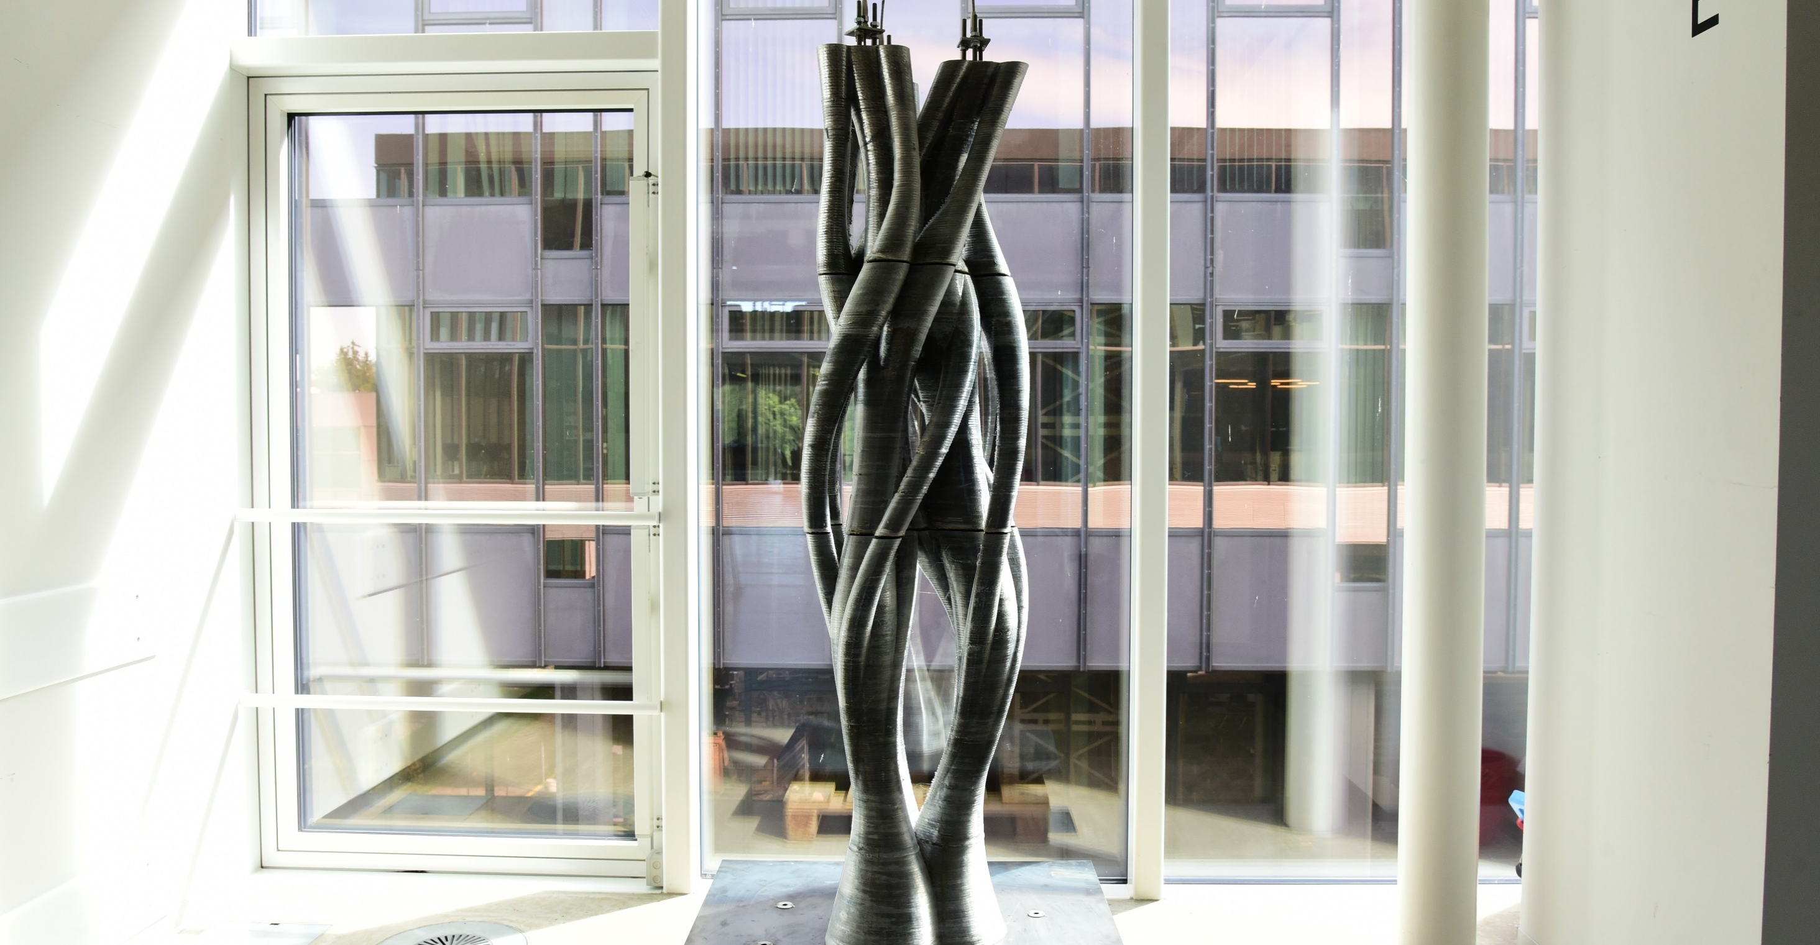
Twisting column 2019

Slide 29
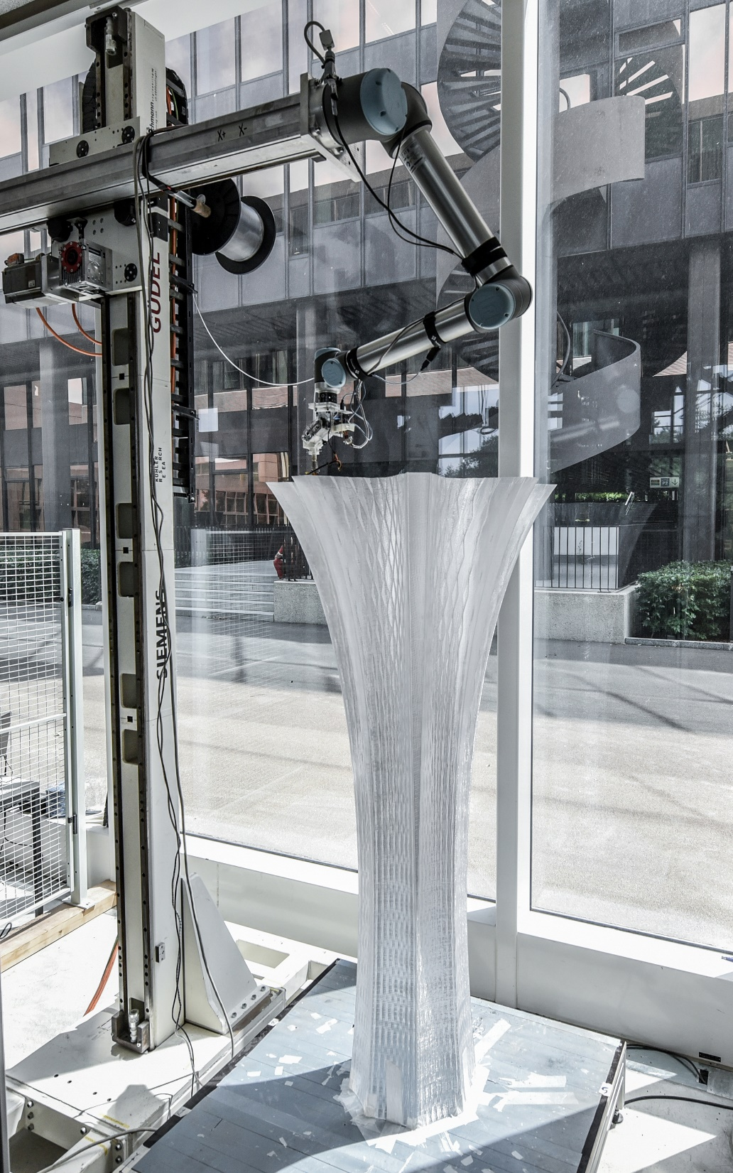
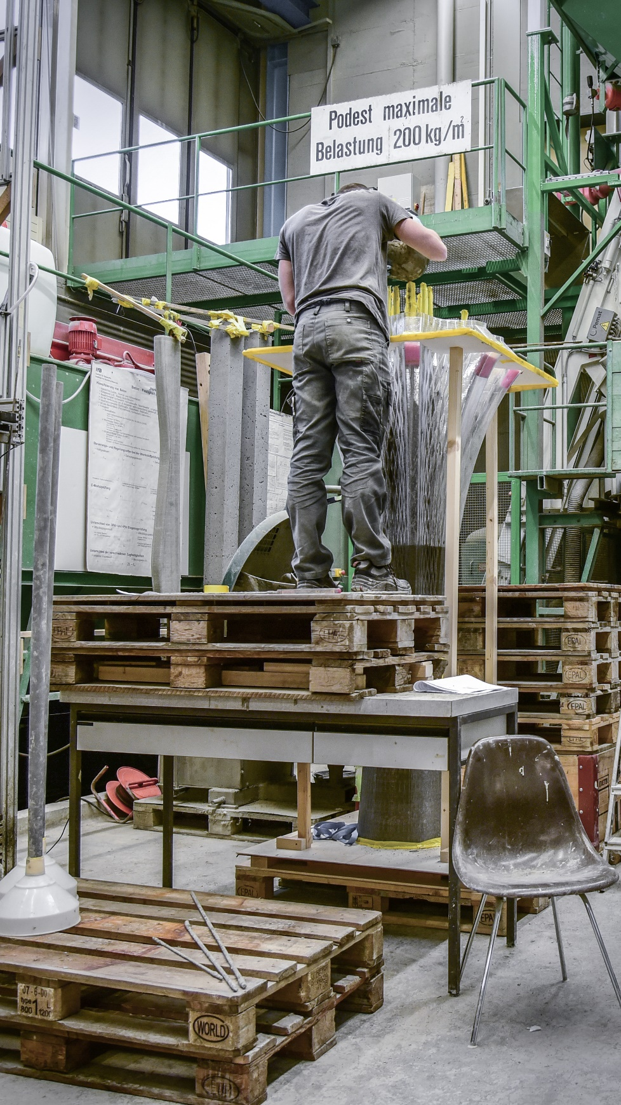
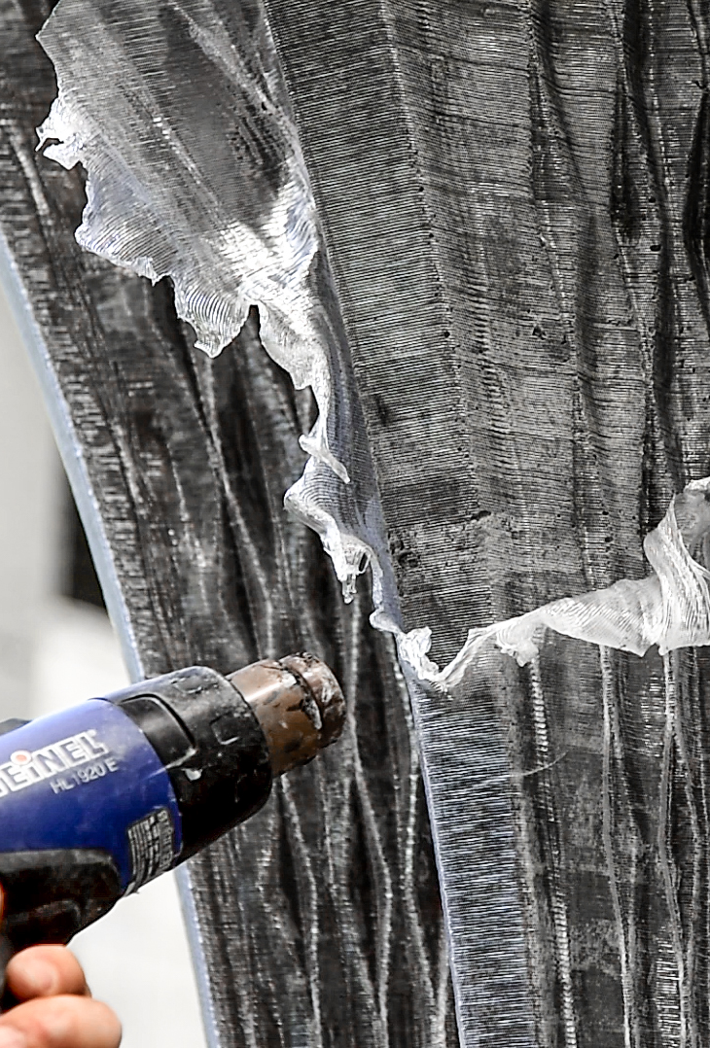
Future Tree (2019)

Slide 30
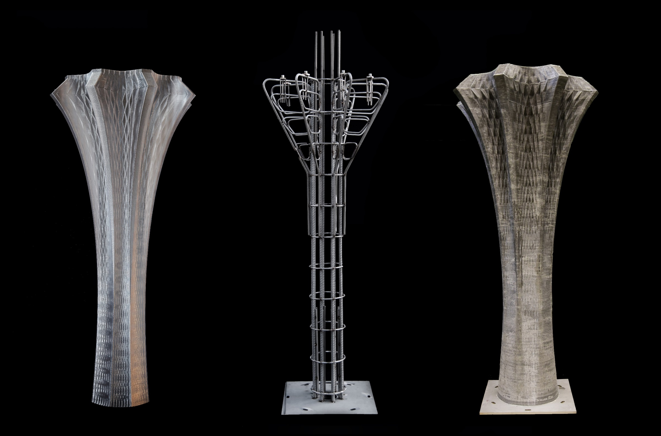

Slide 31
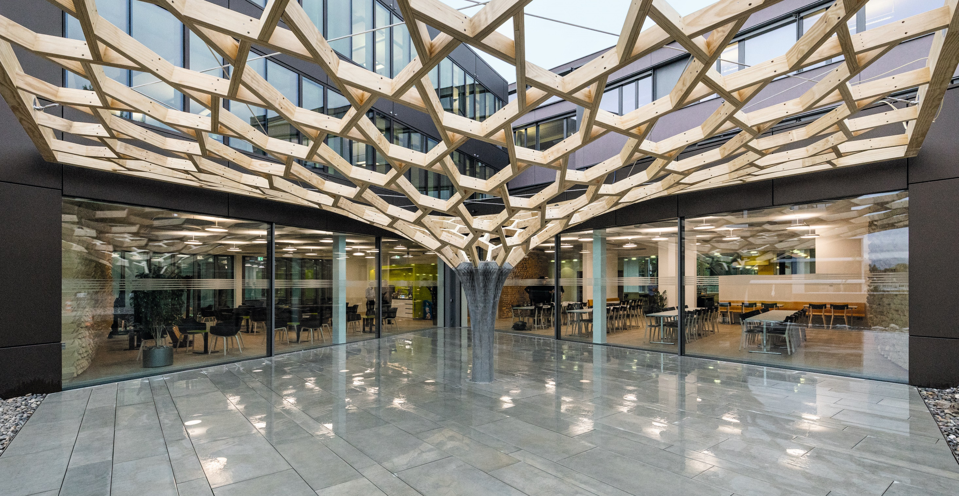

Slide 32
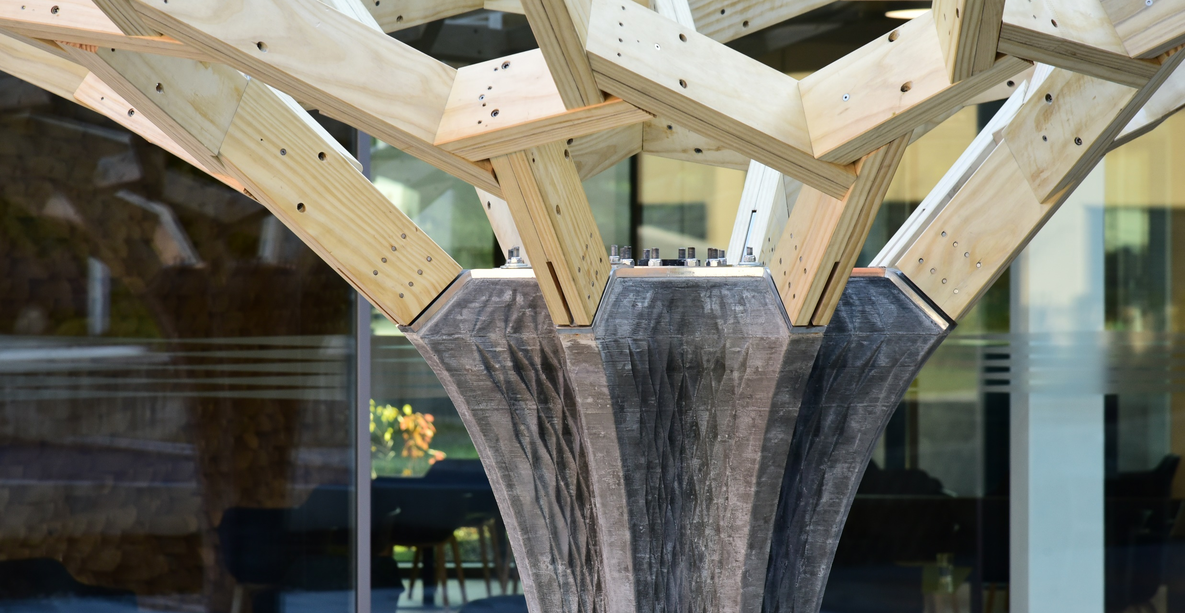

Slide 33
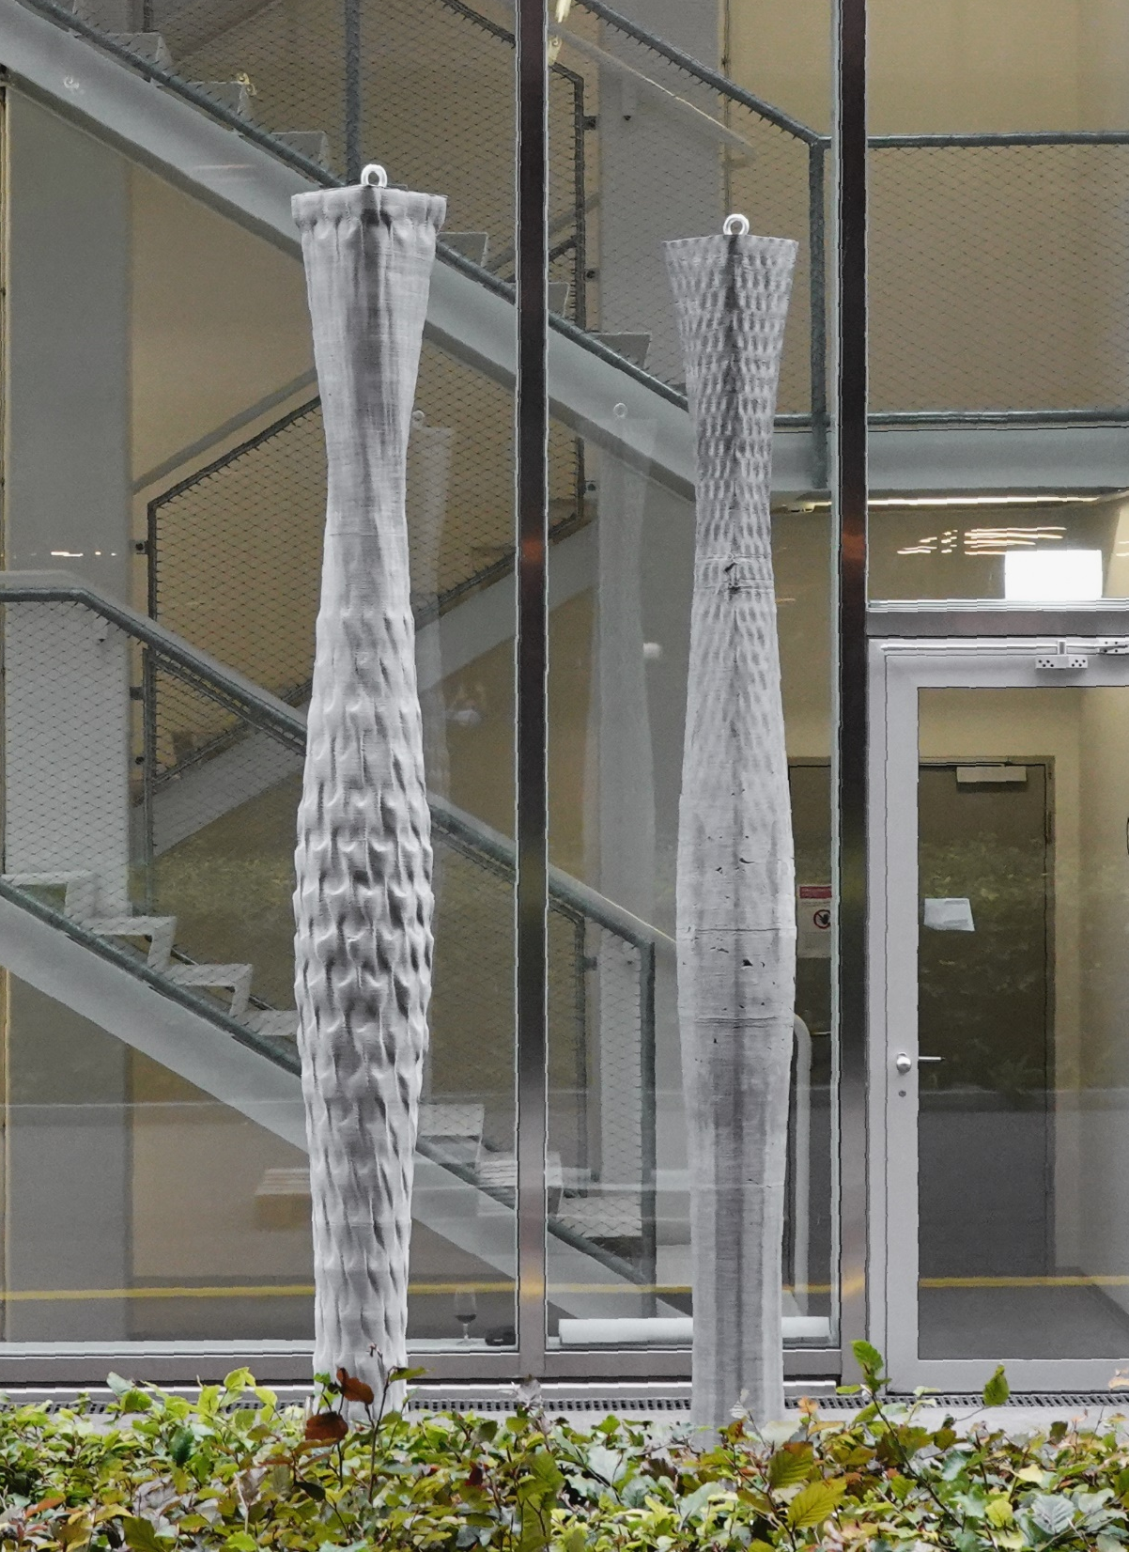
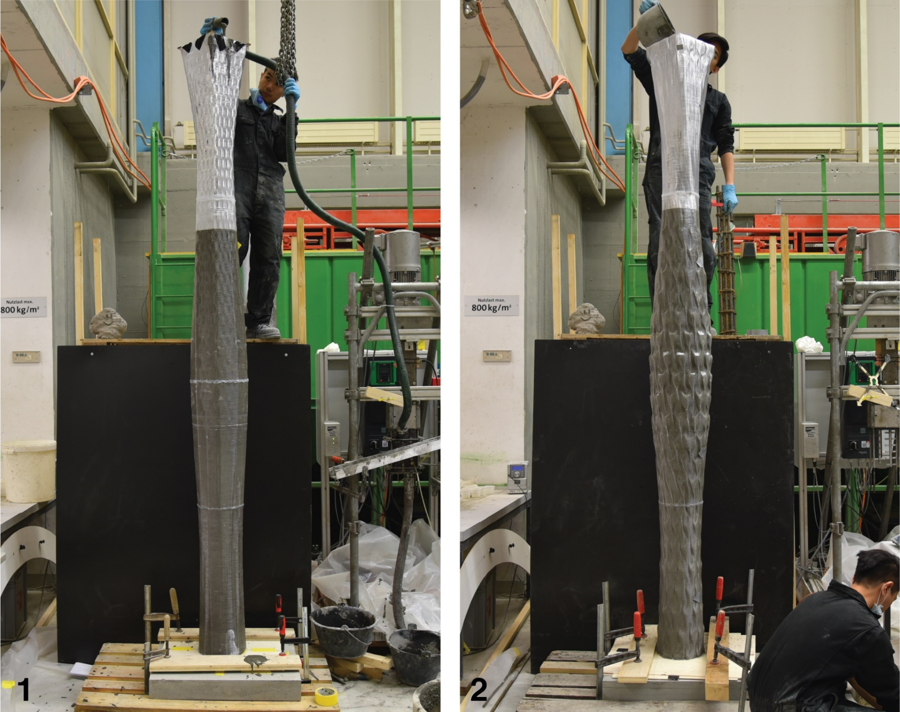
Material-informed column (2020)

Slide 34
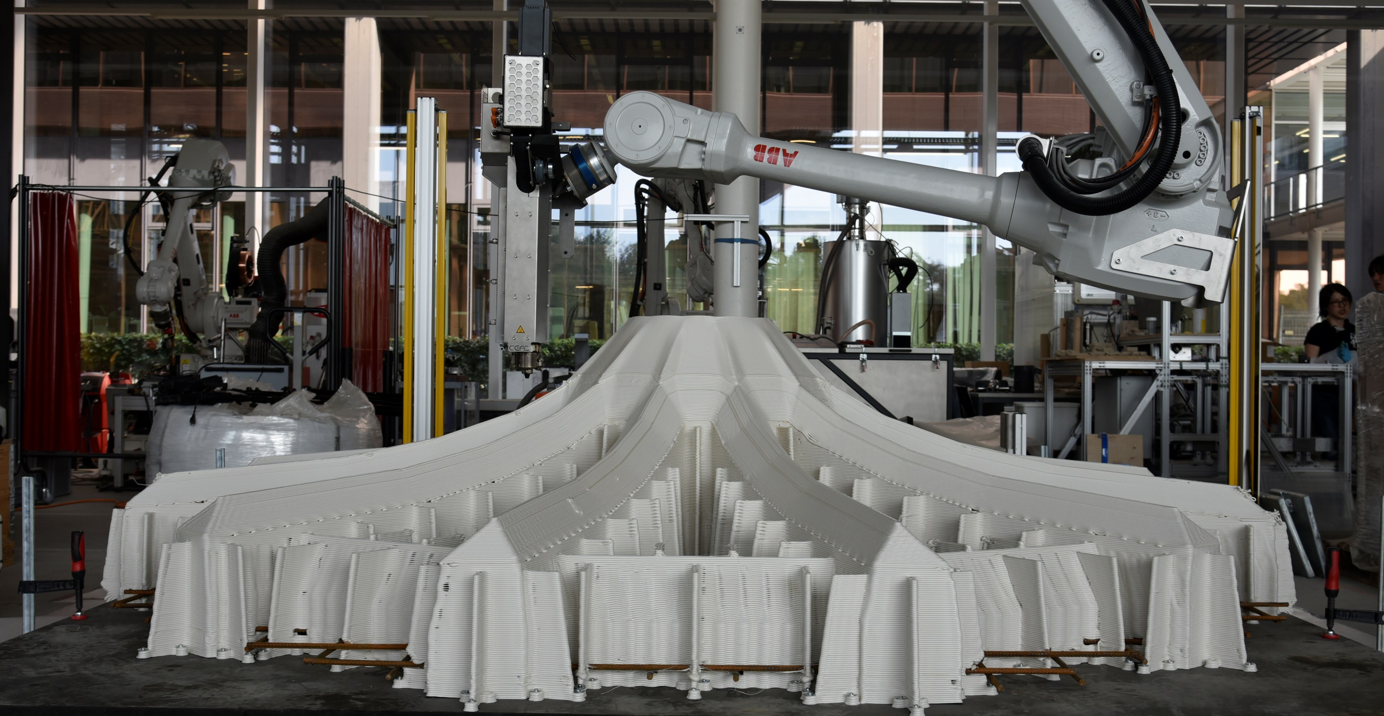
Optimized Ribbed Floor Slab (2021)

Slide 35
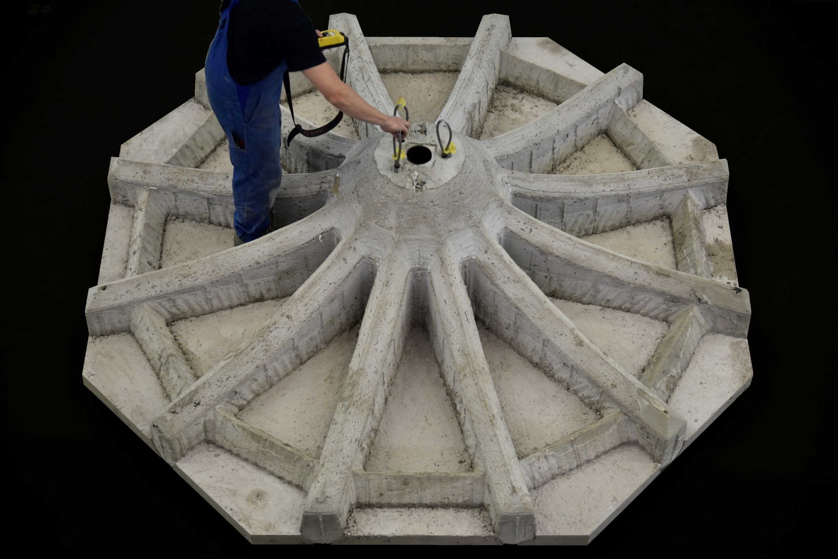

Slide 36
Eggshell Pavillion Workflow
The 2022 MAS Pavilion will make use of the ‘Eggshell’ fabrication technology, currently being researched at Gramazio Kohler Research. Eggshell combines robotic 3D printing with casting of a fast-hardening concrete. By using 3D printing to fabricate the formwork, complex, non-standard elements can be fabricated in an efficient, sustainable process.
Because of the high design freedom that can be achieved, material-efficient, optimized structures can be fabricated. Previous prototypes have shown that it is possible to achieve a material reduction of 50% with this technology.

Slide 37
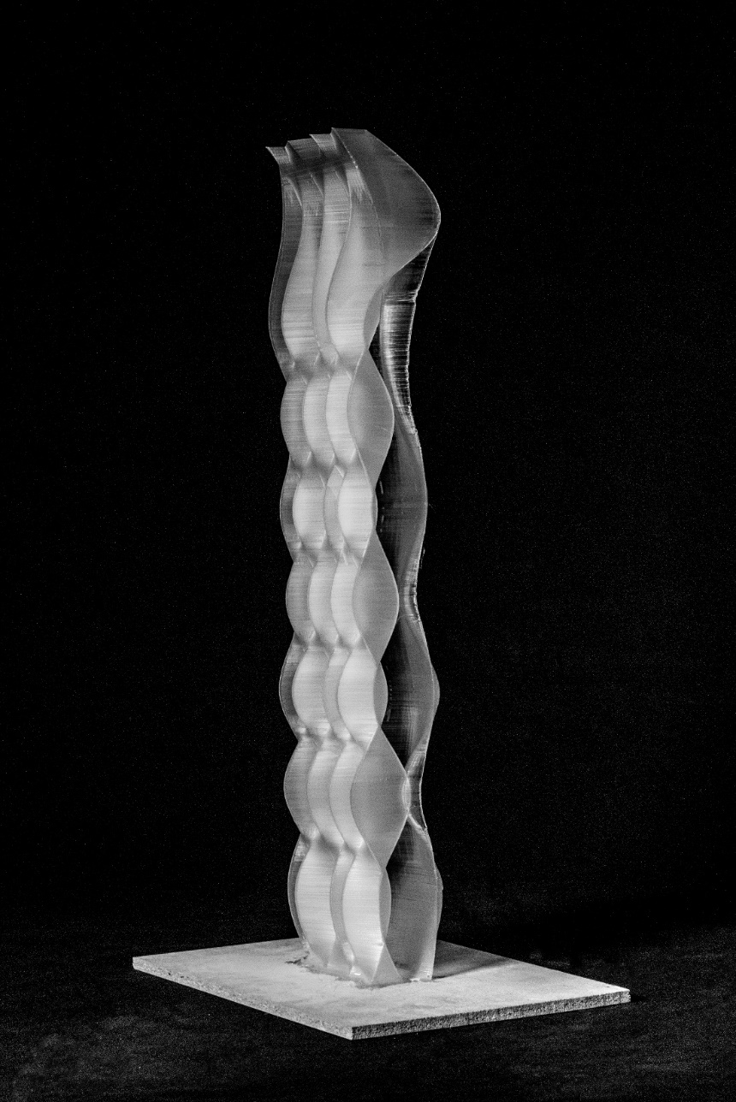
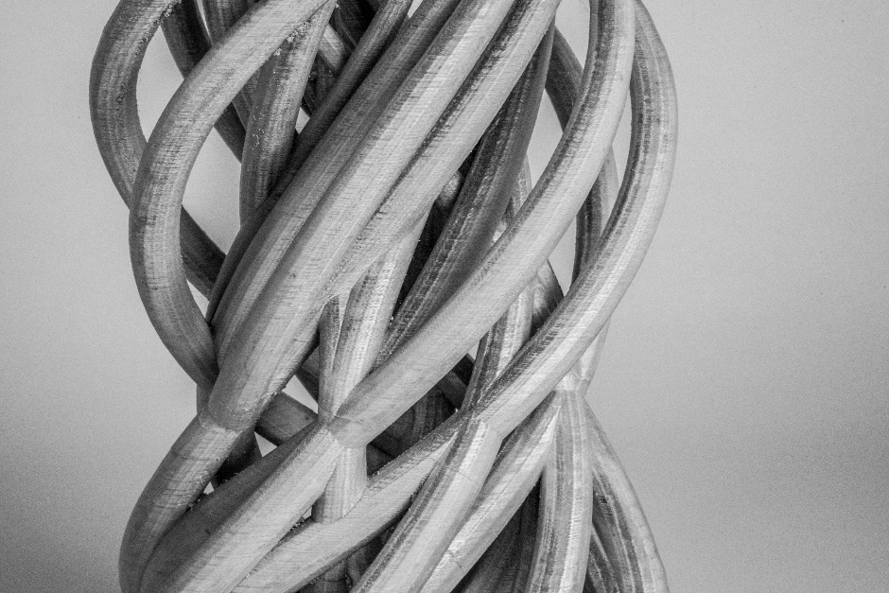
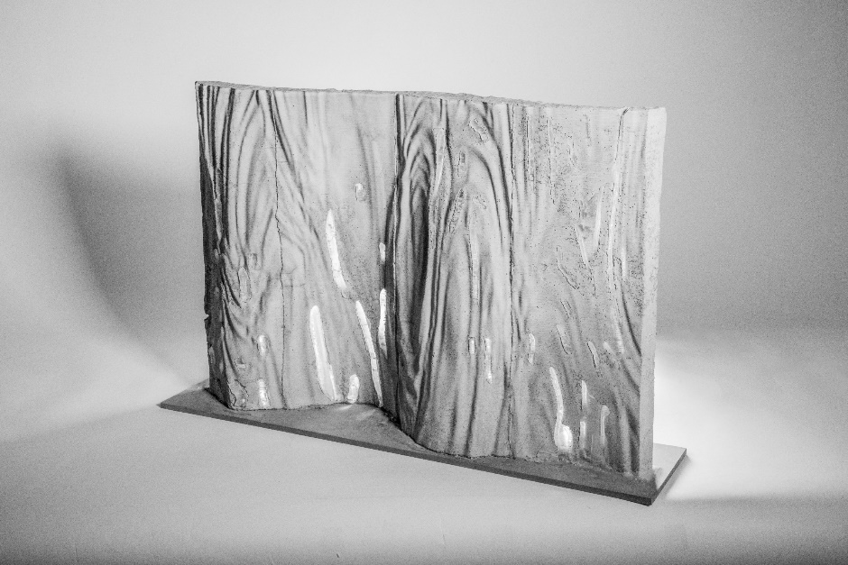
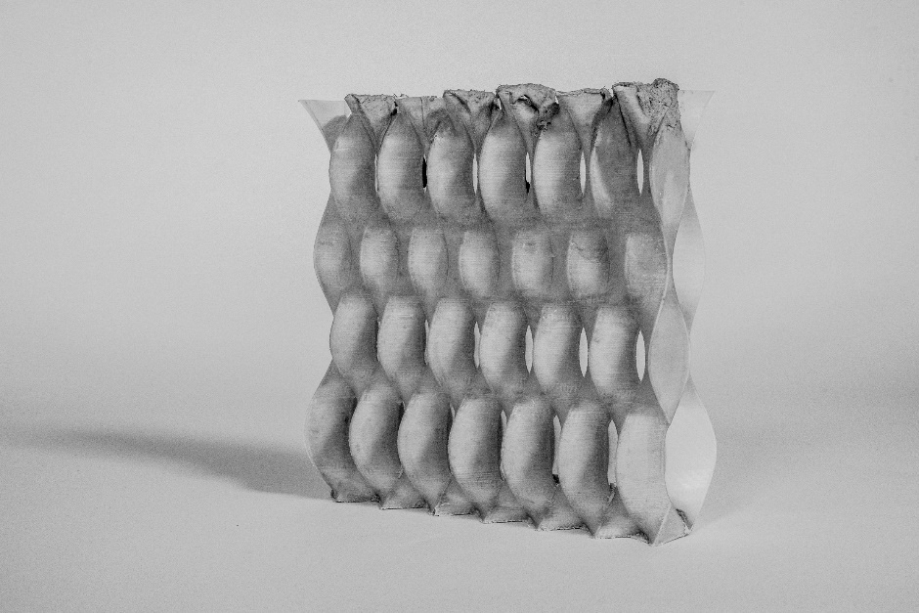
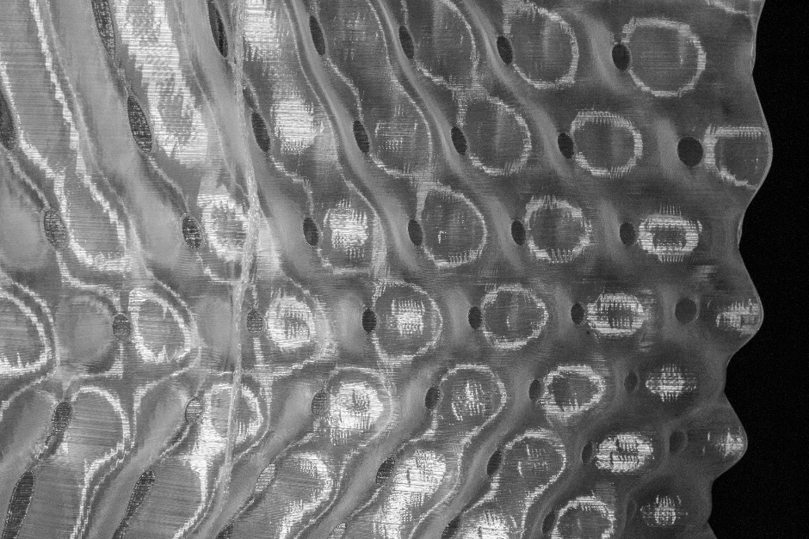
Notes:
Scalebale technologies!

Slide 38
COMPETITION PHASE (SCALE 1:10 – 1:5, WITH Scale setup)
Week 1 - 3: 11.04 – 15.04
1 group per robot 3 students per group
Introducing students (group vise) to Robot studio and RFL set up
First Critiques – decide on design
------------------------------
Week 4-7: 11.04 – 06.05
Two groups of 9 students prototyping and finile design
MID CRIT WITH F+M (Thursday week 7)
Week 8: 09.05 – 13.05
Week 9: 16.05 – 20.05
------------------------------
FABRICATION PHASE (SCALE 1:1, in RFL)
Week 10: 23.05 – 27.05
Week 11: 30.05 – 03.06
Week 12: 06.06 – 09.06

Slide 39
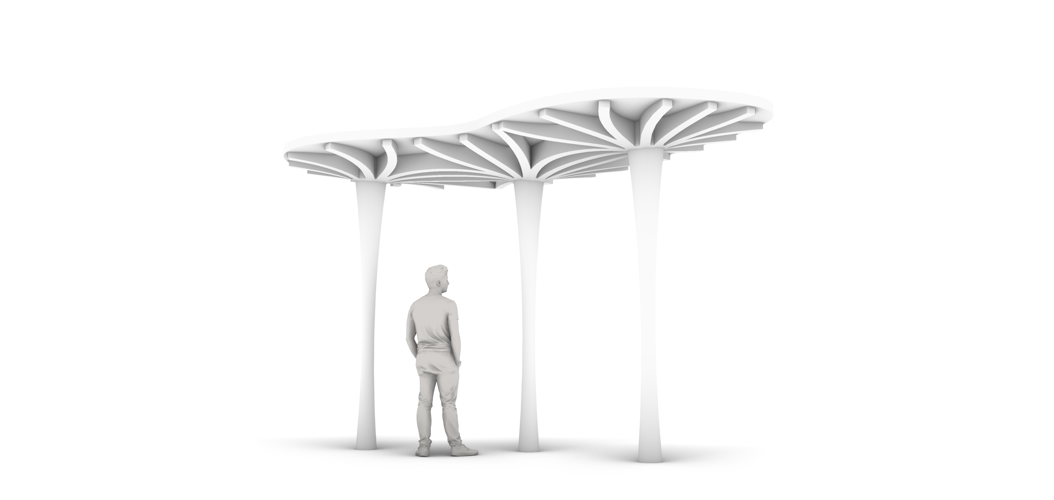
Notes:
The 2022 Pavilion is intended as a demonstration of the possibilities in innovative, sustainable, reinforced concrete construction that can be achieved using the Eggshell technology. It will consist out of multiple prefabricated building components (columns, beams, slabs, etc.). The building components will be prefabricated in our Robotic Fabrication Laboratory at ETH Zurich and shipped to site.
The assignment for the MAS Students will be to produce a design that showcases the unique possibilities offered by the Eggshell process. Several companies have already agreed to act as a sponsor for materials. Currently, we are looking for a suitable site to develop the pavilion.

